Slide 1


NOSQL DATABASE
Dept of ISE
Subject code : 21CS745
Prof. Supriya C
Assistant Professor
Department of ISE
Acharya Institute Of Technology

Slide 2
Why NoSQL?
The Value of Relational Databases
Impedance Mismatch
Application and Integration Databases
Attack of the Clusters
The Emergence of NoSQL.
Aggregate Data Models
Aggregates, Example of Relations and Aggregates
Consequences of Aggregate Orientation
Key-Value and Document Data Models
Column-Family Stores
Summarizing Aggregate-Oriented Databases.
More Details on Data Models
Relationships
Graph Databases
Schemaless Databases
Materialized Views
Modeling for Data Access.
MODULE 1
Dept of ISE

Slide 3
NOSQL DATABASE
Subject code : 21CS745
Chapter 1 : Why NoSQL?
Dept of ISE
Prof. Supriya C
Assistant Professor
Department of ISE
Acharya Institute Of Technology

Slide 4
The Value of Relational Databases
Getting at Persistent Data : most computer architectures have the notion of two areas of memory: a fast volatile “main memory” and a larger but slower “backing store.”
Concurrency : the fact of two or more events or circumstances happening or existing at the same time.
Integration : Using a single database allows all the applications to use each others’ data easily, while the database’s concurrency control handles multiple applications in the same way as it handles multiple users in a single application.
A (Mostly) Standard Model : Relational databases have succeeded because they provide standard model. Although there are differences between different relational databases, the core mechanisms remain the same.

Slide 5
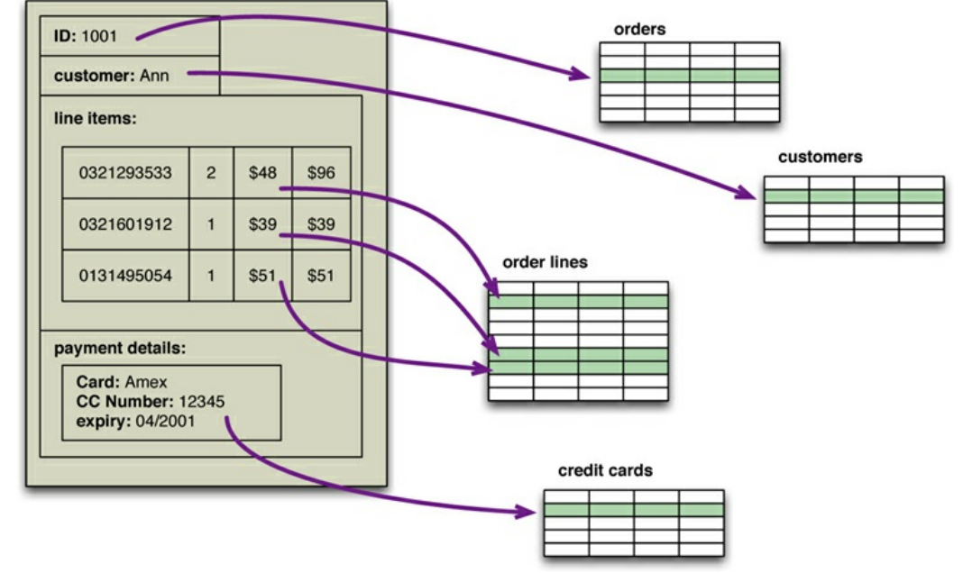
Impedance Mismatch
Application developers have been frustrated with the impedance mismatch between the relational data structures and the in-memory data structures of the application. Using NoSQL databases allows developers to develop without having to convert in-memory structures to relational structures.
An order, which looks like a single aggregate structure in the UI, is split into many rows from many tables in a relational database

Slide 6
Application and Integration Databases
The primary factor was the role of SQL as an integration mechanism between applications generally termed as Integration database.
Multiple applications, usually developed by separate teams, storing their data in a common database. This improves communication because all the applications are operating on a consistent set of persistent data.
A structure that’s designed to integrate many applications ends up being more complex than any single application needs.
An application want to make changes to its data storage, it needs to coordinate with all the other applications using the database. Different applications have different structural and performance needs.
With an application database, only the team using the application needs to know about the database structure, which makes it much easier to maintain and evolve the schema.

Slide 7
Attack of the Clusters
In 2000s did see several large web properties dramatically increase in scale. This increase in scale was happening along many dimensions. Websites started tracking activity and structure in a very detailed way.
Coping with the increase in data and traffic required more computing resources.
Scaling up implies bigger machines, more processors, disk storage, and memory.
But bigger machines get more and more expensive and the alternative is to use lots of small machines in a cluster.
Relational databases are not designed to be run on clusters.
Clustered relational databases use a cluster-aware file system that writes to a highly available disk subsystem—but this means the cluster still has the disk subsystem as a single point of failure.

Slide 8
Contd..
7. This mismatch between relational databases and clusters led some organization consider an alternative route to data storage.
8. Two companies in particular—Google and Amazon, Both were on the forefront of running large clusters of this kind; furthermore, they were capturing huge amounts of data.
9. BigTable from Google and Dynamo from Amazon, two different NOSQL service’s that is used to run high-performance applications at ant scale But bigger machines get more and more expensive and the alternative is to use lots of small machines in a cluster.

Slide 9
The Emergence of NoSQL
“NoSQL” first made its appearance in the late 90s as the name of an open-source relational database Led by Carlo Strozzi.
The name comes from the fact that the database doesn’t use SQL as a query language. Instead, the database is manipulated through shell scripts that can be combined into the usual UNIX pipelines.
Most NoSQL databases are driven by the need to run on clusters. NoSQL databases offer a range of options for consistency and distribution.
NoSQL is an accidental neologism. There is no prescriptive definition—all you can make is an observation of common characteristics.
The common characteristics of NoSQL databases are
• Not using the relational model
• Running well on clusters
• Open-source
• Built for the 21st century web estates
• Schemaless
6. The most important result of the rise of NoSQL is Polyglot Persistence.

Slide 10
NOSQL DATABASE
Subject code : 21CS745
Chapter 2 : Aggregate Data Models
Dept of ISE
Prof. Supriya C
Assistant Professor
Department of ISE
Acharya Institute Of Technology

Slide 11
Aggregate
A data model is the model through which we perceive and manipulate our data and it also describes how we interact with the data in the database.
This is distinct from a storage model, which describes how the database stores and manipulates the data internally.
Aggregate is a term that comes from Domain-Driven Design. In Domain-Driven Design, an aggregate is a collection of related objects that we wish to treat as a unit.
Aggregates make it easier for the database to manage data storage over clusters.
Aggregate-oriented databases work best when most data interaction is done with the same aggregate.
Ex: when there is need to get an order and all its details, it better to store order as an aggregate object
Dept of ISE

Slide 12
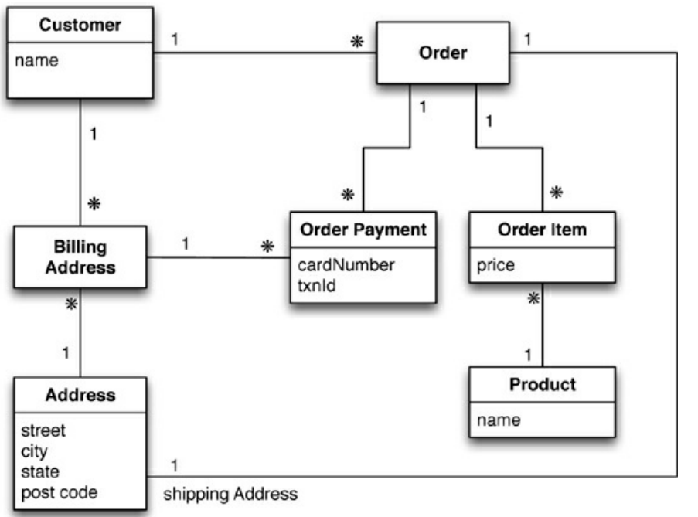
A data model
Dept of ISE
Note: Address is strongly aggregated into Customer (implicit cardinality 0..1). Order is a strong aggregation of Address, OrderItem and Payment. Payment is a strong aggregation of Addresses (strong aggregation means that a single istance of Address is aggregated into a single instance of Customer, or Order, or Payment, but not in more than one)

Slide 13
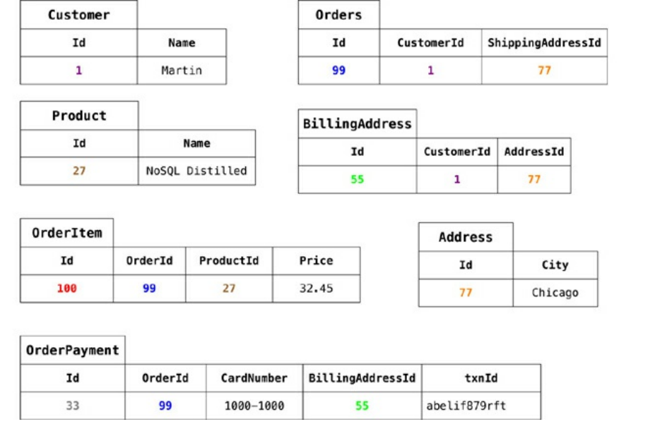
Sample data for the above model
Dept of ISE

Slide 14
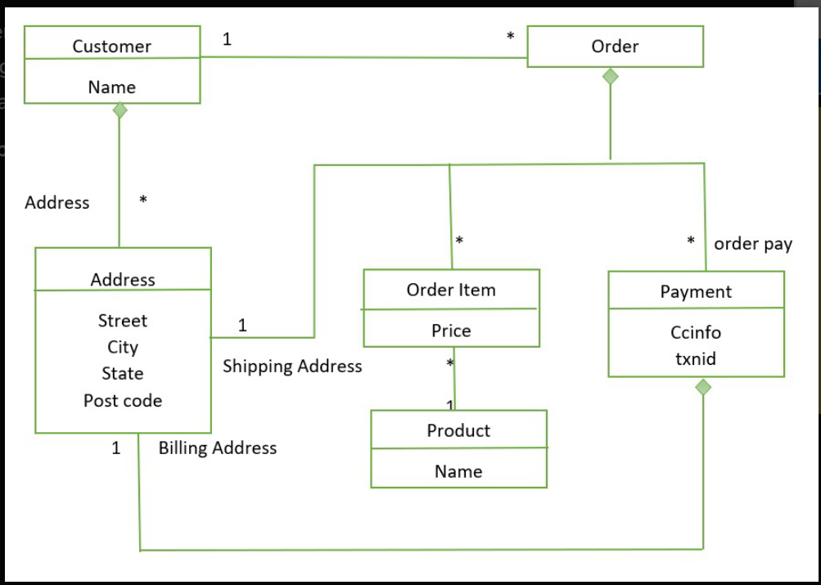
Example of Relations and Aggregates
Customer and Orders link between them represent an aggregate.
The diamond shows how data fit into the aggregate structure.
Customer contains a list of billing address
Payment also contains the billing address
The address appears three times and it is copied each time
The domain is fit where we don’t want to change shipping and billing address.
Dept of ISE

Slide 15
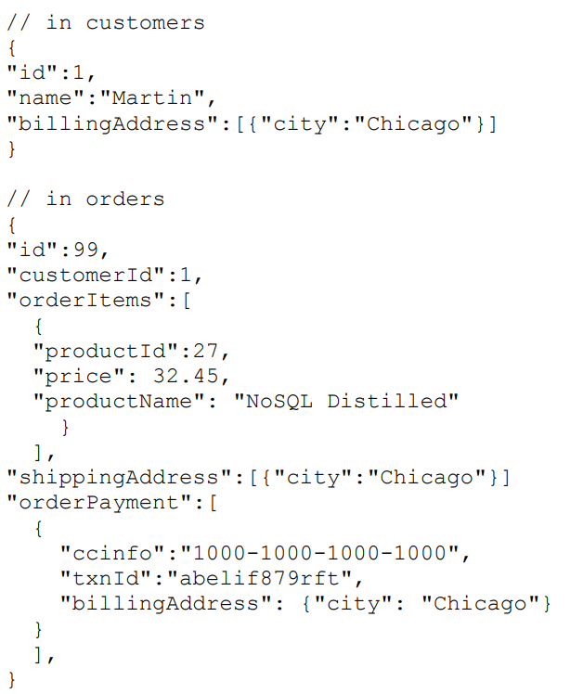
JSON format- A common representation for data in NoSQL
Dept of ISE

Slide 16
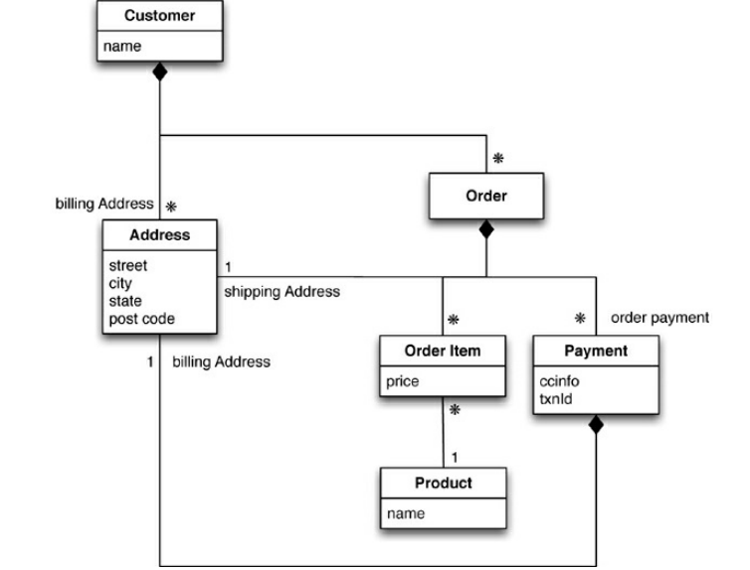
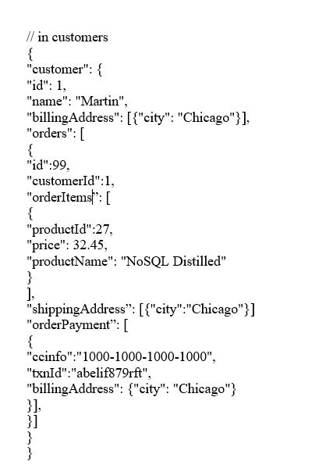
Embed all the objects for customer and the customer’s orders - An alternative way of aggregating data
Dept of ISE

Slide 17
Consequences of Aggregate Orientation
Aggregation is not a logical data property it is all about how the data is being used by applications.
It has an important consequence for transactions.
NoSQL databases don’t support ACID (Atomic, Consistent, Isolated, and Durable) transactions thus sacrificing consistency.
Aggregate-oriented databases support the atomic manipulation of a single aggregate at a time.
If a retailer wants to analyze its product sales over the last few months, then an order aggregate becomes a trouble. To get to product sales history, you’ll have to dig into every aggregate in the database.
An aggregate structure may be an obstacle for others but help with some data interactions.
Dept of ISE

Slide 18
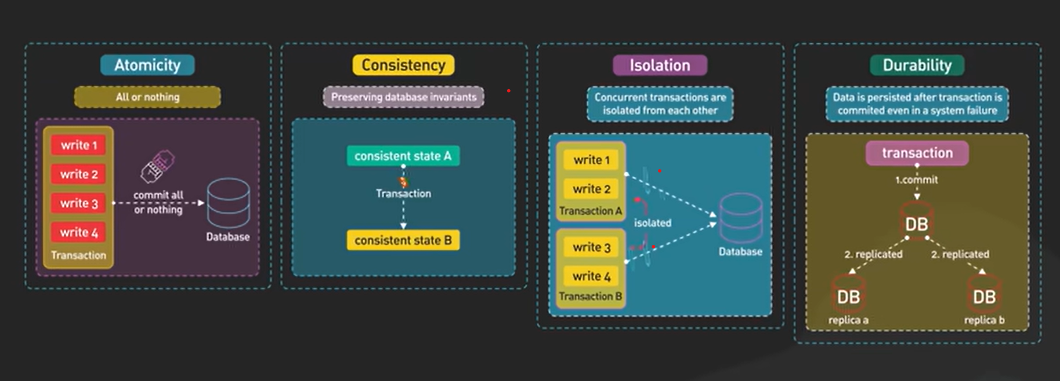
Pictorial Representation of ACID property
Dept of ISE

Slide 19
ACID Properties
Atomicity: ensures that all the commands in a transaction are treated as a single unit and either all succeed or all fail.
Consistency: in a database management system (DBMS) ensures that data changes are valid and in line with all defined rules.
Isolation: the ability of a database to allow a transaction to execute as if there are no other concurrently running transactions.
Durability: ensures that changes made to a database are permanent, even if there are system failures.
Dept of ISE

Slide 20
Differences between aggregate oriented and aggregate ignorant databases
Aggregate-oriented databases make inter-aggregate relationships more difficult to handle than intra-aggregate relationships.
Aggregate-ignorant databases are better when interactions use data organized in many different formations
Dept of ISE

Slide 21
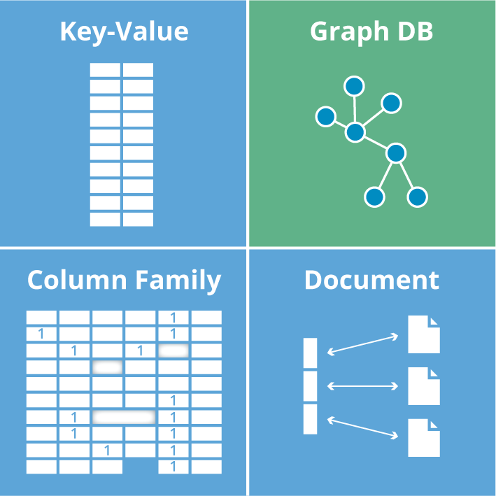
Types of NoSQL database
Dept of ISE

Slide 22
Key value store: allows you to store any type of data under a unique key., examples – Memcached, Redis, Coherence
Column-based Database: store data under a column of your choice., examples – Hbase, Big Table, Accumulo
Graph Databases: establish edges and properties for nodes that represent data elements.,examples – Amazon Neptune, Neo4j
Document-based Database : uses a similar approach by aggregating different data types within a single JSON or XML document.,examples – MongoDB, CouchDB, Cloudant
Dept of ISE

Slide 23
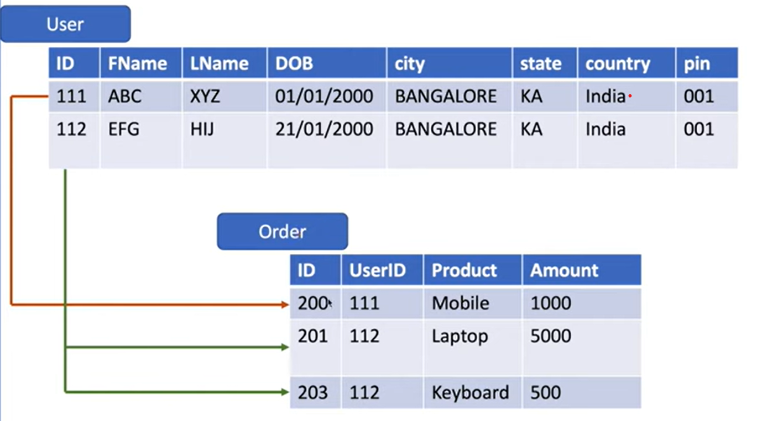
Relational Databases
Dept of ISE

Slide 24
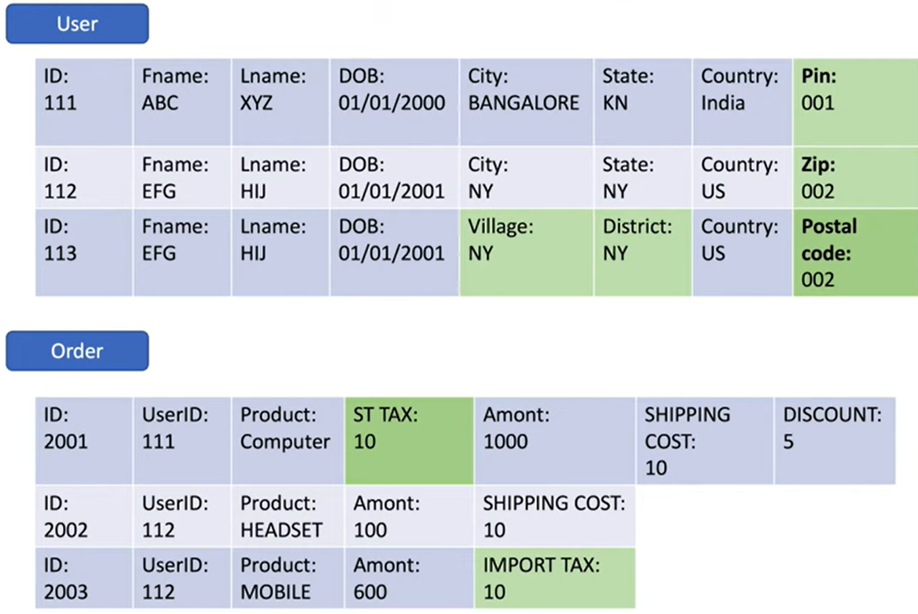
Dept of ISE

Slide 25
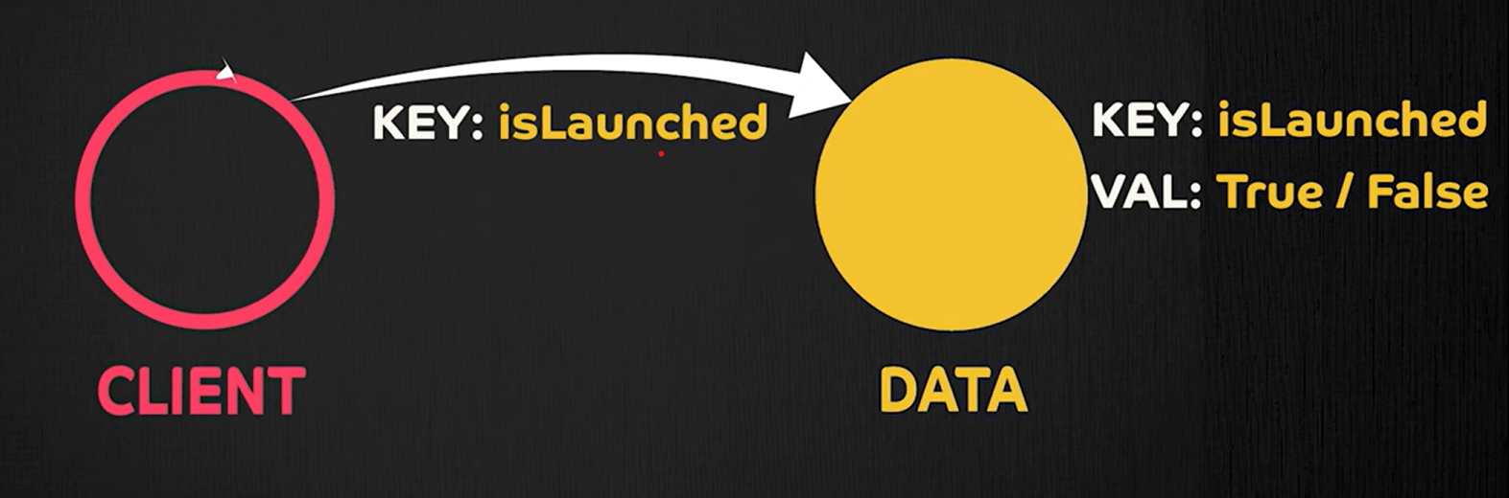
Key-value databases
Key-value databases, sometimes referred to as key-value stores, use the simplest data model – the pairing of a key and a value.
An application retrieves the value using the unique key.
The value can contain any data structure or type. It is up to the application trying to access the data to understand the content.
Dept of ISE

Slide 26
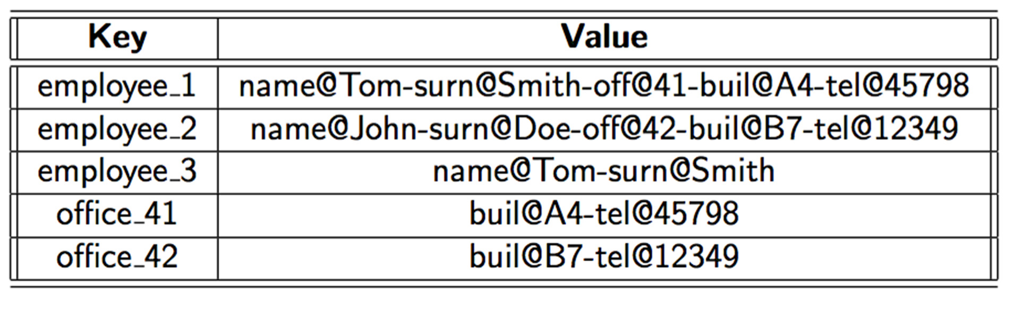
Key Value Store
Popular Use cases
Caching
Session management
Leadboard
Dept of ISE
Example
Redis
DynamoDB
Oracle NoSQL

Slide 27
Document Store
Document databases store partially structured data in documents, using JSON, BSON, XML, or other formats.
The data inside the document is semi-structured to provide more flexibility when querying.
Unlike basic key-value stores, the user does not need to retrieve the entire record, only the relevant part of the document.
Web-facing documents, user comments, and web-publishing apps all benefit from this data model.
Famous document-based NoSQLs are MongoDB, OrientDB, Apache CouchDB, and MarkLogic.
Dept of ISE

Slide 28
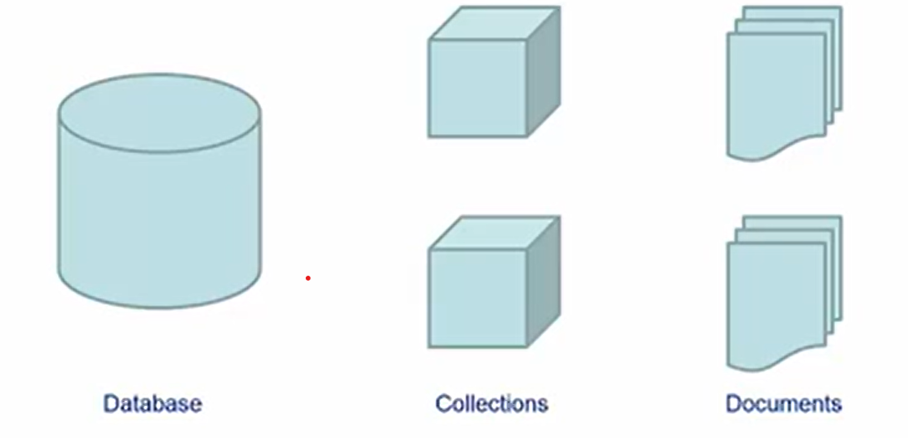
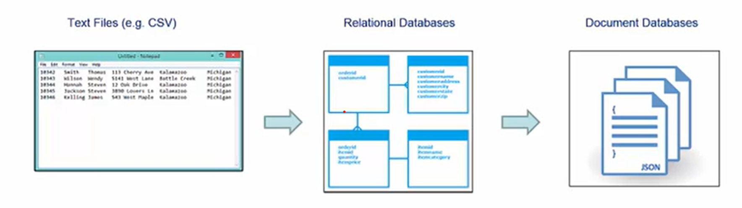
Document Store
Documents are gathered together in collections within the database. Document DB’s can be seen as a next step in the evolution of data stores.
Dept of ISE

Slide 29
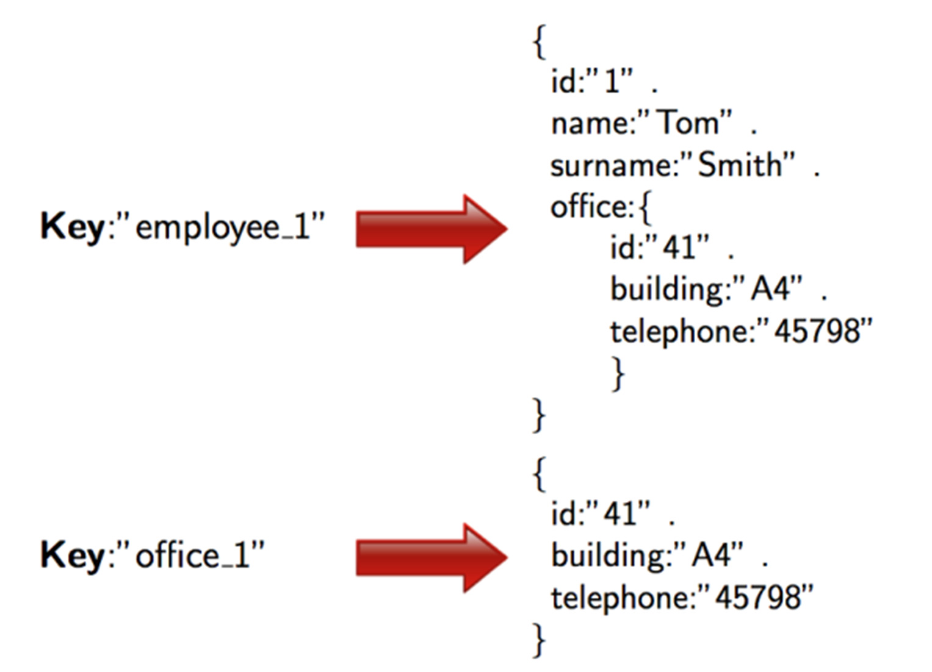
Document Store
Popular Use cases
Blog/ website
Products catalog Big Data/ Analytics
Dept of ISE
Example
MongoDB
Apache CouchDB
Azure COSMOS DB

Slide 30
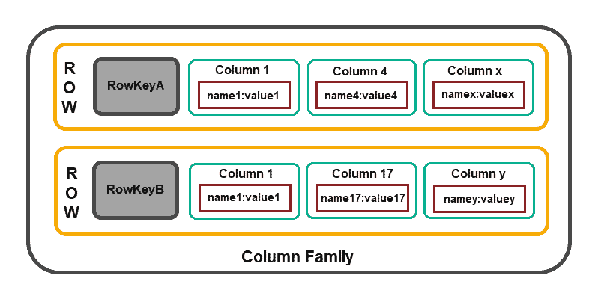
Column Family Stores
Column-based databases focus on the efficiency of read operations. If you need to read several columns of multiple rows quickly, it makes sense to organize data in groups of columns (i.e., column families).
The model structure consists of a row identifier that defines the aggregated data and the row aggregate that is composed of more detailed, secondary-level values (i.e., columns).
Dept of ISE

Slide 31
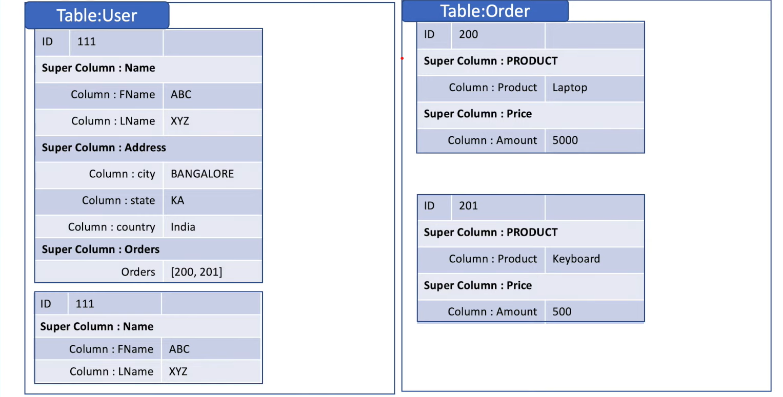
Column family according to the BigTable terminology is somehow equivalent to Cassandra super columns, i.e., columns that contain nested columns.
Popular Use cases
IOT
Inventory management
Big data
Dept of ISE
Example
Cassandra
HBase

Slide 32
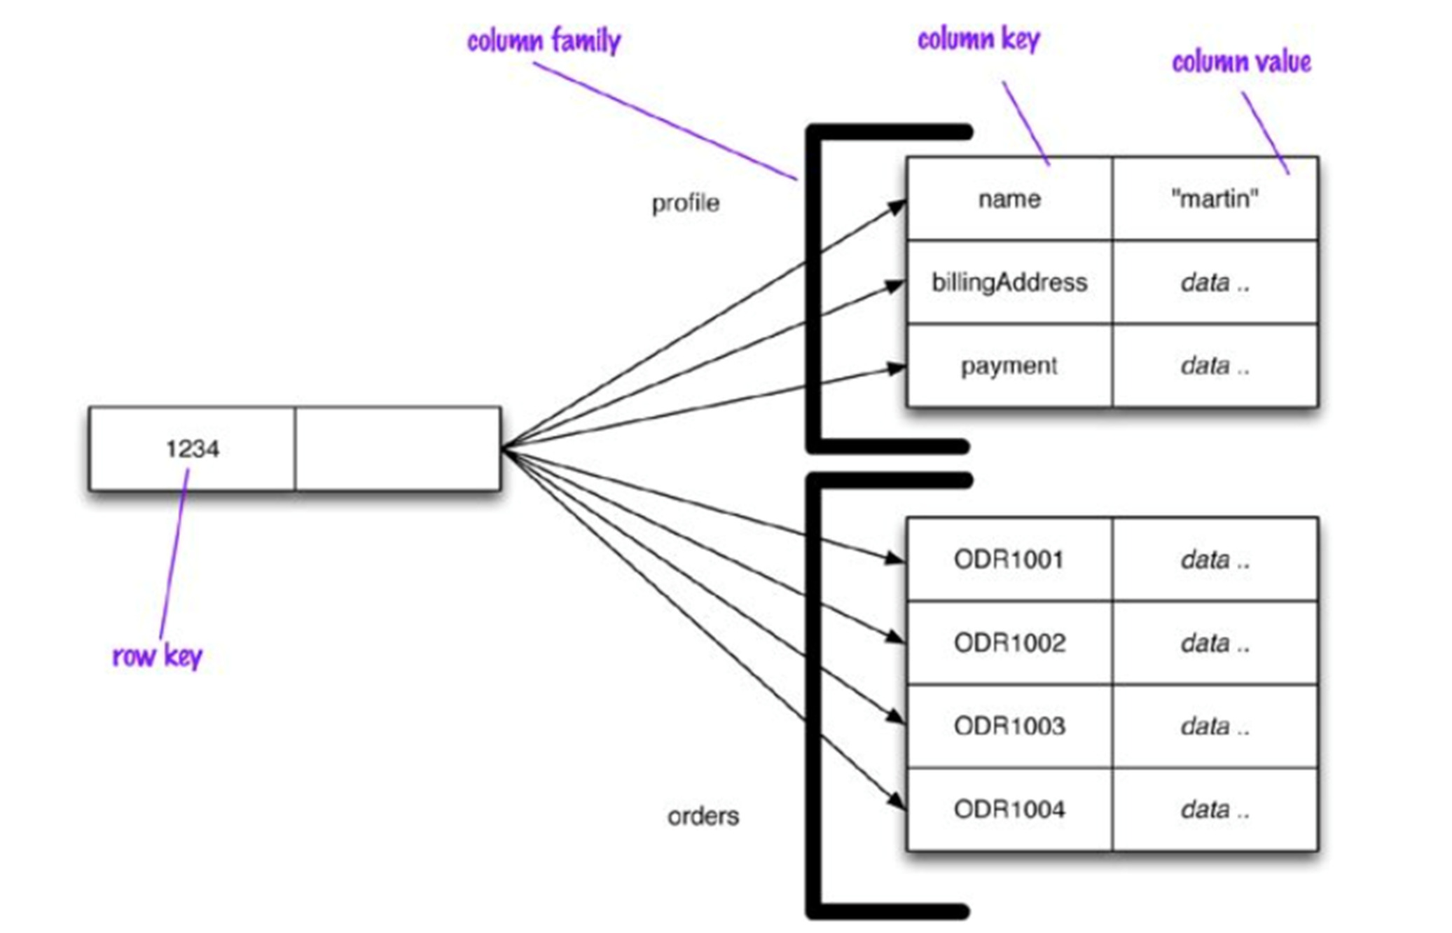
Dept of ISE

Slide 33
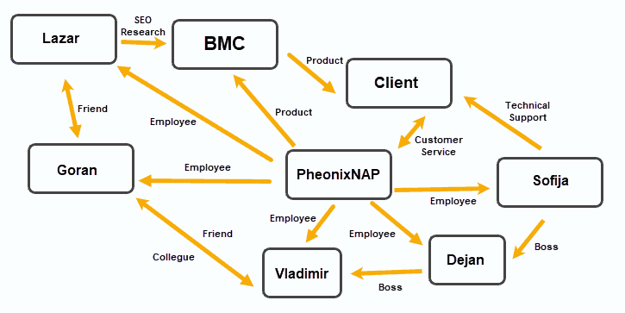
Graph Database
Graph databases organize data into Nodes, with Edges establishing relationships between these data nodes.
This data storage model proved to be useful in applications that emphasize relationships, such as social media platforms, customer relations software, and travel and reservation systems.
Document-based OrientDB and MarkLogic can function as graph databases.
JanusGraph, RedisGraph, and Neo4j are popular graph-based solutions.
Dept of ISE

Slide 34
NOSQL DATABASE
Subject code : 21CS745
Chapter 3 : More Details on Data Models
Dept of ISE
Prof. Supriya C
Assistant Professor
Department of ISE
Acharya Institute Of Technology

Slide 35
Relationships
Aggregates are useful in that they put together data that is commonly accessed together
An important aspect of relationships between aggregates is how they handle updates.
Relational databases will allow us to modify multiple records in a single transaction, providing ACID guarantees while altering many rows.
If you have data based on lots of relationships, you should prefer a relational database over a NoSQL store.
Aggregate-oriented databases become more awkward as you need to operate across multiple aggregates.
Dept of ISE

Slide 36
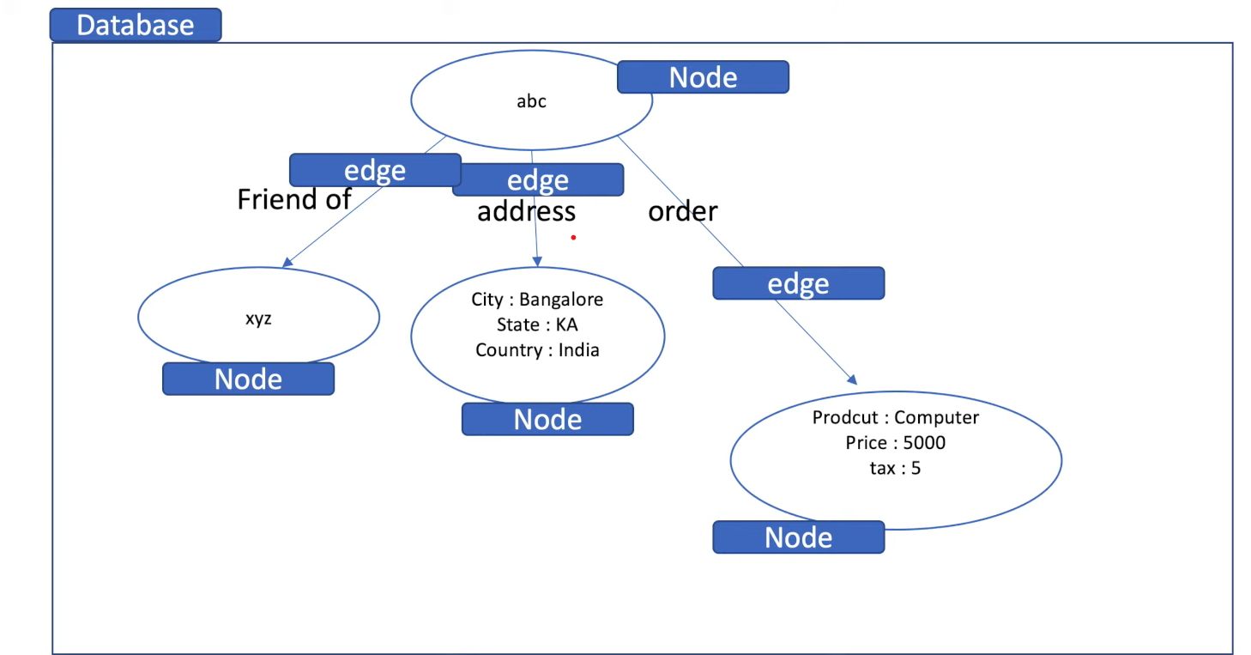
Graph Databases
Most NoSQL databases were inspired by the need to run on clusters, which led to aggregate-oriented data models of large records with simple connections.
Popular Use cases
Social Networking
IAM
Recommendation
Dept of ISE
Example
Neo4j
JanusGraph

Slide 37
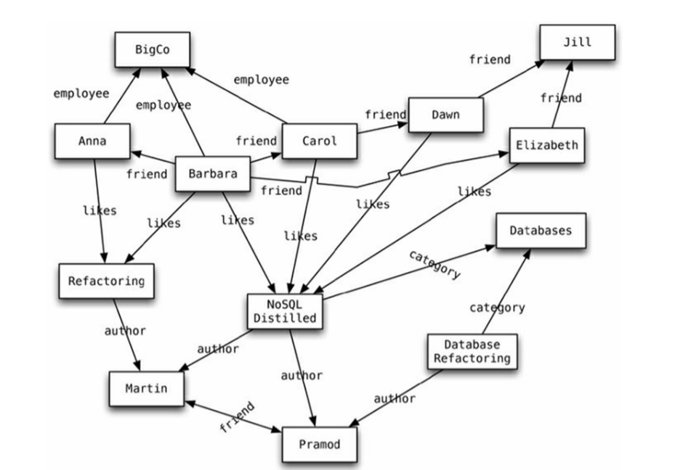
Graph Databases
We have a web of information whose nodes are very small (nothing more than a name) but there is a rich structure of interconnections between them. With this structure, we can ask questions such as “find the books in the Databases category that are written by someone whom a friend of mine likes.”
This is ideal for capturing any data consisting of complex relationships such as social networks, product preferences, or eligibility rules.
Dept of ISE

Slide 38
Schemaless Databases
A common theme across all the forms of NoSQL databases is that they are schemaless. When you want to store data in a relational database. Schema—a defined structure for the database which says what tables exist, which columns exist, and what data types each column can hold. With NoSQL databases, storing data is much more casual.
A key-value store allows you to store any data you like under a key.
A document database effectively does the same thing, since it makes no restrictions on the structure of the documents you store.
Column-family databases allow you to store any data under any column you like.
Graph databases allow you to freely add new edges and freely add properties to nodes and edges as you wish.
Dept of ISE

Slide 39
Schemaless databases
NoSQL databases are schemaless:
A key-value store allows you to store any data you like under a key.
A document database effectively does the same thing, since it makes no restrictions on the structure of the documents you store.
Column-family databases allow you to store any data under any column you like.
Graph databases allow you to freely add new edges and freely add properties to nodes and edges as you wish.
This has various advantages:
Without a schema binding you, you can easily store whatever you need, and change your data storage as you learn more about your project
You can easily add new things as you discover them
A schemaless store also makes it easier to deal with nonuniform data: data where each record has a different set of fields (limiting sparse data storage)
Dept of ISE

Slide 40
Schemaless databases
Schemaless is appealing, but it brings some problems of its own
Indeed, whenever we write a program that accesses data, that program almost always relies on some form of implicit schema: it will assume that certain field names are present and carry data with a certain meaning, and assume something about the type of data stored within that field
Having the implicit schema in the application means that in order to understand what data is present you have to dig into the application code.
Furthermore, the database remains ignorant of the schema: it cannot use the schema to support the decision on how to store and retrieve data efficiently. Also, it cannot impose integrity constraints to maintain information coherent
Dept of ISE

Slide 41
//pseudo code
foreach (Record r in records)
{
foreach (Field f in r.fields)
{
print(f.name, f.value)
}
}
It will assume that certain field names are present and carry data with a certain meaning, and assume something about the type of data stored within that field.
This implicit schema is a set of assumptions about the data’s structure in
the code that manipulates the data.
Schemas have value, and the rejection of schemas by NoSQL databases is indeed quite startling.
Dept of ISE

Slide 42
Schemaless Database
Since the implicit schema is into the application code that accesses it, the situation becomes problematic if multiple applications access the same database
These problems can be reduced with a couple of approaches.
One approach : is to encapsulate all database interaction within a single application and integrate it with other applications using web services.
Another approach: is to clearly delineate different areas of an aggregate for access by different applications.
Dept of ISE

Slide 43
Materialized Views
A view is like a relational table (it is a relation) but it’s defined by computation over the base tables. When you access a view, the database computes the data in the view—a handy form of encapsulation.
Views provide a mechanism to hide from the client whether data is derived data or base data.
Although NoSQL databases don’t have views as relational databases, they may have precomputed and cached queries, and they use the term “materialized views” to describe them.
Dept of ISE

Slide 44
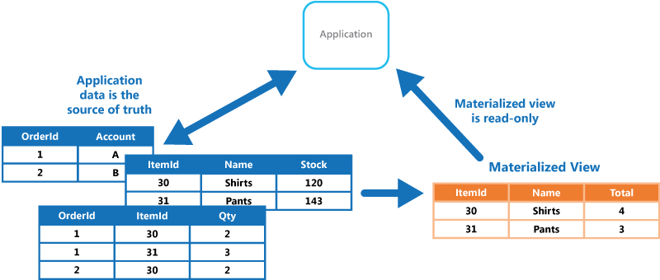
Materialized Views
Dept of ISE

Slide 45
Approaches for Materialized Views
There are two rough strategies to building a materialized view.
The first is the eager approach where you update the materialized view at the same time you update the base data for it. In this case, adding an order would also update the purchase history aggregates for each product.
The application database approach is valuable here as it makes it easier to ensure that any updates to base data also update materialized views.
We can build materialized views outside of the database by reading the data, computing the view, and saving it back to the database. More often databases will support building materialized views themselves.
Dept of ISE

Slide 46
Modelling for Data access
Despite several NoSQL tools have been developed in the last years, and various technical solutions have been proposed so far, to date no methodologies have been developed to guide the database designer in the modeling of a NoSQL database
This contrasts with the well established methodologies available for the design of a relational database
This is however justified by the fact that NoSQL data models and technologies are still in their infancy
Methodologies need thus to be devised to both (i) model data (e.g., decide the form of aggregates in aggregate DBs), and (ii) distribute data on a cluster (in this respect, we notice that no consolidated methodologies exist even for distributing relational databases over several storage nodes in a network)
In what follows we limit to present some general considerations on data modeling with the help of an example
Dept of ISE

Slide 47
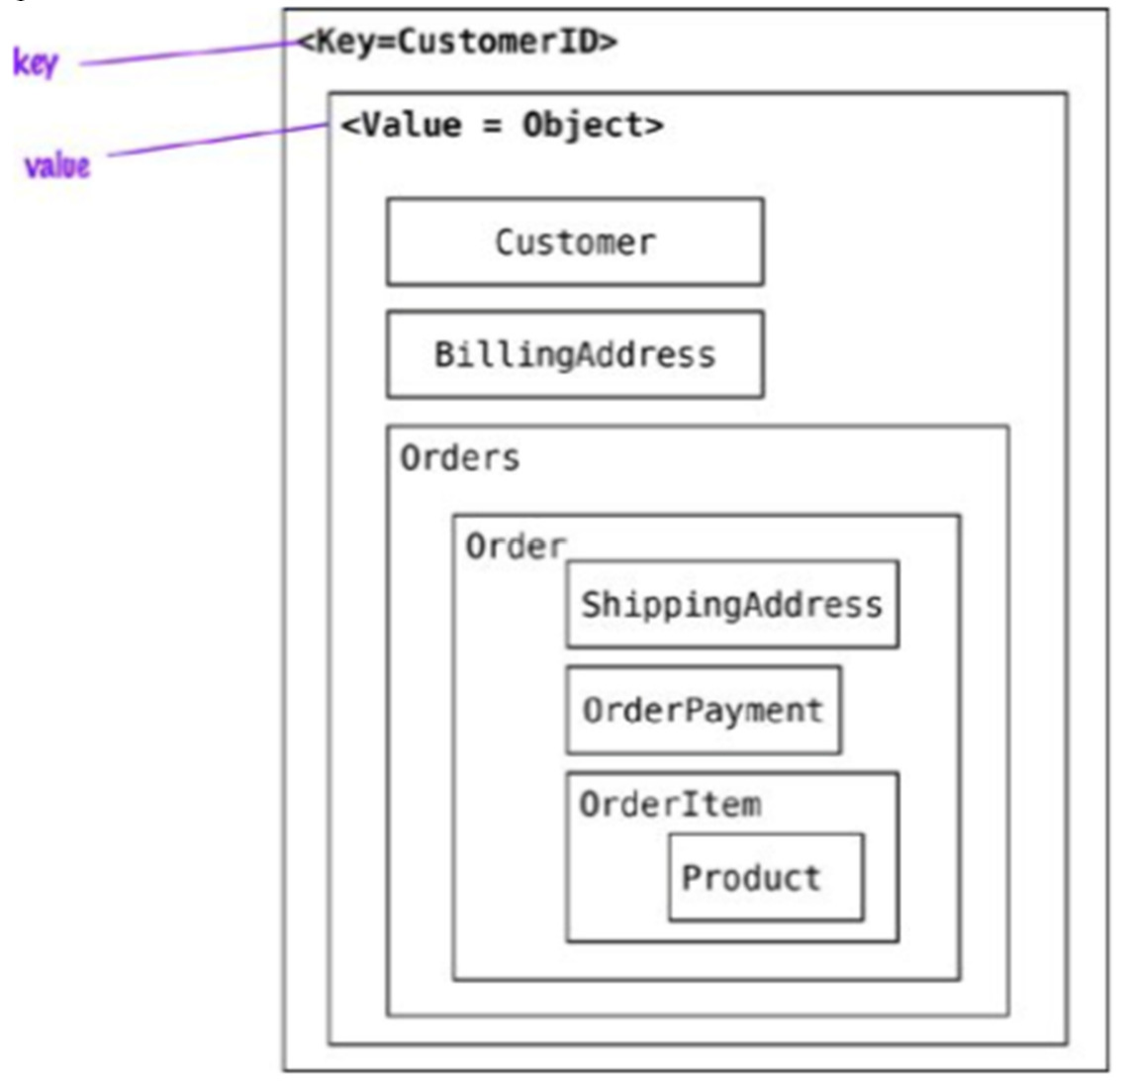
Modelling for Data access
When modeling data aggregates we need to consider how the data is going to be read (and what are the side effects with the chosen aggregates)
Example: Let’ s start with the model where all the data for the customer is embedded using a key-value store
The application can read the customers information and all the related data by using the key
To read the orders or the products sold in each order, the whole object has to be read and then parsed on the client side
Dept of ISE

Slide 48
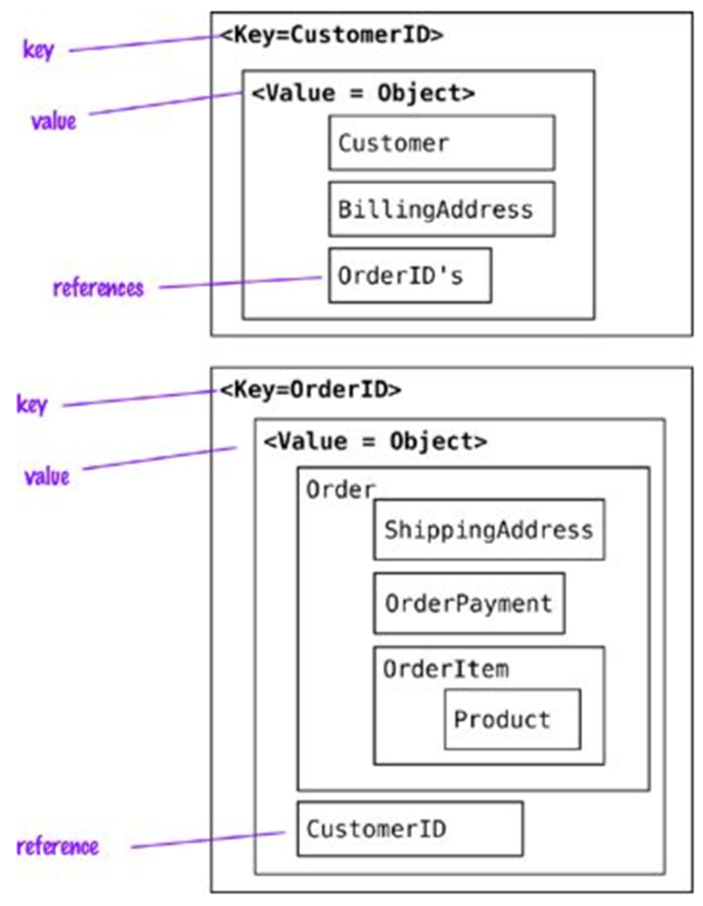
Data Modeling
When references are needed we should change the data for the key- value store to split the value object into Customer and Order objects and then maintain these objects reference
We can now find the orders independently from the Customer, and access then the customer using the CustomerID reference in the Order, whereas with the OrderId in the Customer we can find all Orders for the Customer
Using aggregates this way allows for read optimization, but we have to push the OrderId reference into Customer for every new Order
Dept of ISE

Slide 49
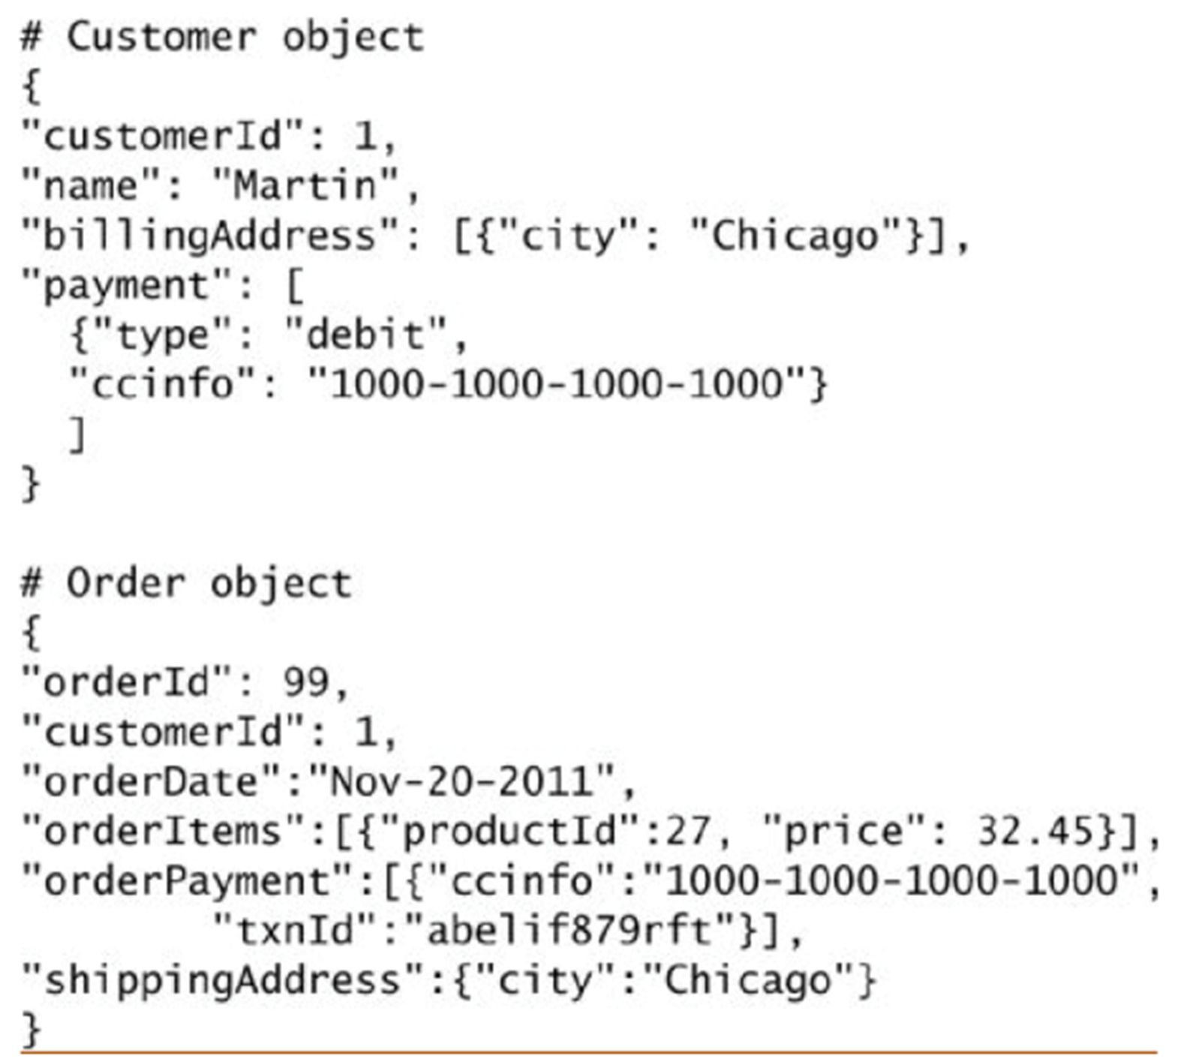
Data Modeling
In document stores, since we can query inside documents, we can find all Orders for the Customer even removing references to Orders from the Customer object.
This change allows us to not update the Customer object when orders are placed by the Customer
Dept of ISE

Slide 50
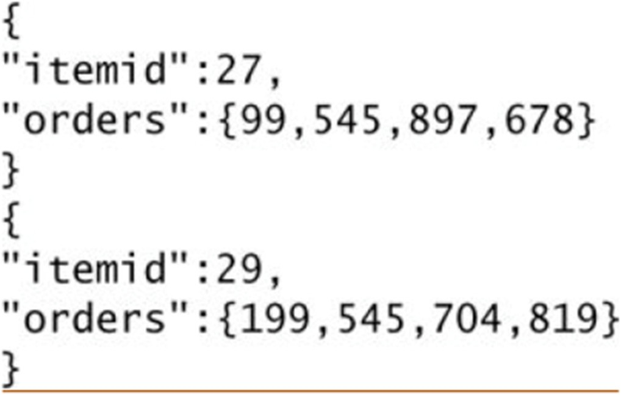
Data Modeling
Aggregates can also be used to obtain analytics; for example, an aggregate update may fill in information on which Orders have a given Product in them.
This denormalization of the data allows for fast access to the data we are interested in and is the basis for Real Time Businees Intelligence or Real Time Analytics: enterprises do not have to rely on end-of-the-day batch to populate data warehouses tables and generate analytics.
Of course, only pre-packed analyses are possible through this approach
Dept of ISE
document store modeling

Slide 51
Data Modeling
Remark:
Since document data stores allow you to query by attributes inside the document, searches such as “find all orders that include the ‘Divina Commedia’ product” are possible
Creating an aggregate in a document store of product and orders it belongs to is therefore not necessary for obtaining the result we are looking for, but rather for optimizing the way we obtain it.
Dept of ISE

Slide 52
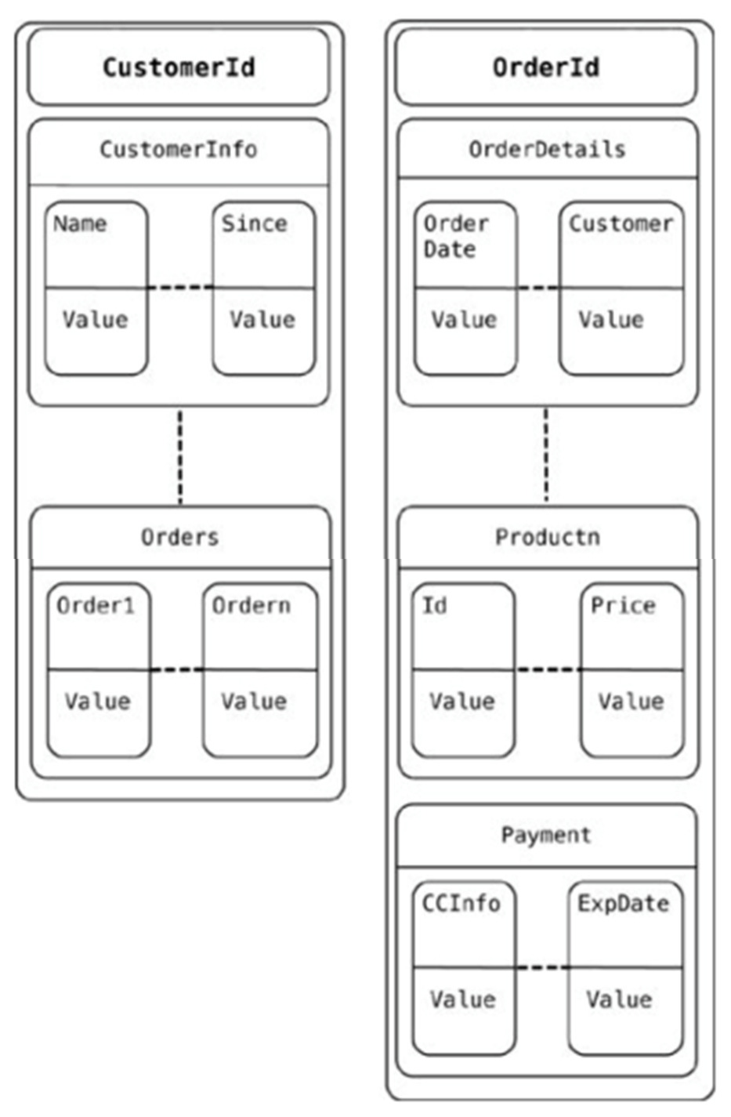
Data Modeling
When using the column families to model the data, we can model the schema a little more. Obviously, there are multiple ways to model the data
In our example, one way is to store the Customer and Order in different column families
The reference to all the orders placed by the customer are in the Customer column family. Similar other denormalizations are generally done so that query (read) performance is improved
Dept of ISE

Slide 53
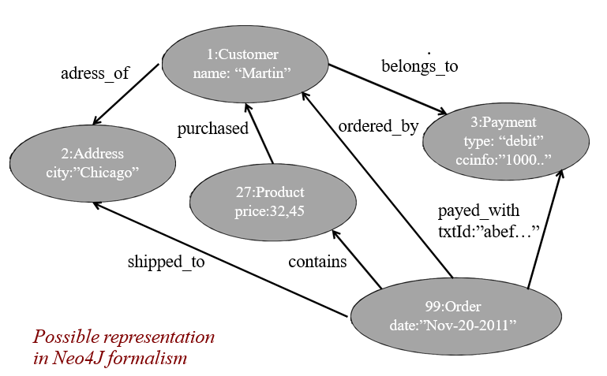
Data Modeling
When using graph databases to model the same data, we model all objects as (typed) nodes and relations within them as (typed) edges; both nodes and edges may have properties (key/value pairs). This is especially convenient when you need to use the data to recommend products to users or to find patterns in actions taken by users.
Dept of ISE

Slide 54
Consider the below given Use cases:
a) Content Management System and
b) College Library Management System.
Compare the key features of Relational Database and NOSQL Database for above given use cases and come up with the conclusion which database is suitable for these two use cases and why?
Dept of ISE

Slide 55

Dept. of ISE

